Slide 1
Work with Delta Lake tables in Microsoft Fabric
Module 3

Slide 2
Module Objectives
Understand Delta Lake and delta tables in Microsoft Fabric
1
Create and manage delta tables using Spark
2
Use Spark to query and transform data in delta tables
3
Use Delta tables with Spark structured streaming
4
Notes:
Tables in a Microsoft Fabric lakehouse are based on the Delta Lake storage format commonly used in Apache Spark. By using the enhanced capabilities of delta tables, you can create advanced analytics solutions.
Tables in a Microsoft Fabric lakehouse are based on the Linux foundation Delta Lake table format, commonly used in Apache Spark. Delta Lake is an open-source storage layer for Spark that enables relational database capabilities for batch and streaming data. By using Delta Lake, you can implement a lakehouse architecture to support SQL-based data manipulation semantics in Spark with support for transactions and schema enforcement. The result is an analytical data store that offers many of the advantages of a relational database system with the flexibility of data file storage in a data lake.

Slide 3
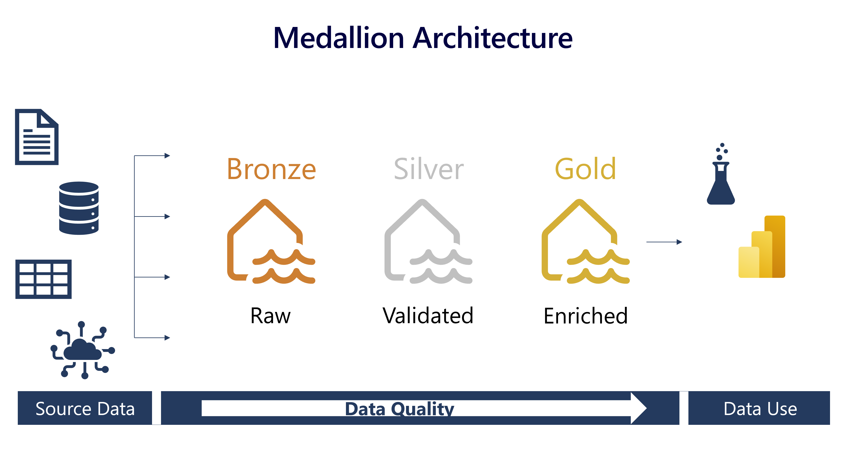
Lakehouse Medallion Architecture
Notes:
Many lakehouses use a medallion architecture. A medallion architecture is a data design pattern used to logically organize data in a lakehouse, with the goal of incrementally and progressively improving the structure and quality of data as it flows through each layer of the architecture (from Bronze ⇒ Silver ⇒ Gold layer tables). Medallion architectures are sometimes also referred to as "multi-hop" architectures.
The bronze or raw layer of the medallion architecture is the first layer of the lakehouse. It's the landing zone for all data, whether it's structured, semi-structured, or unstructured. The data is stored in its original format, and no changes are made to it.
The silver or validated layer is the second layer of the lakehouse. It's where you'll validate and refine your data. Typical activities in the silver layer include combining and merging data and enforcing data validation rules like removing nulls and deduplicating. The silver layer can be thought of as a central repository across an organization or team, where data is stored in a consistent format and can be accessed by multiple teams. In the silver layer you're cleaning your data enough so that everything is in one place and ready to be refined and modeled in the gold layer.
The gold or enriched layer is the third layer of the lakehouse. In the gold layer, data undergoes further refinement to align with specific business and analytics needs. This could involve aggregating data to a particular granularity, such as daily or hourly, or enriching it with external information. Once the data reaches the gold stage, it becomes ready for use by downstream teams, including analytics, data science, or MLOps. The gold layer often contains a dimensional model or star schema.
Depending on your organization's specific use case, you may have a need for more layers. For example, you might have an additional "raw" layer for landing data in a specific format before it's transformed into the bronze layer. Or you might have a "platinum" layer for data that's been further refined and enriched for a specific use case. Regardless of the names and number of layers, the medallion architecture is flexible and can be tailored to meet your organization's particular requirements. You can have multiple gold layers for different audiences or domains. For example, you might have a gold layer for your finance team and a separate gold layer for your sales team. You might also have a gold layer for your data scientists that is optimized for machine learning. Depending on your needs, you might also use a Data Warehouse as your gold layer.

Slide 4
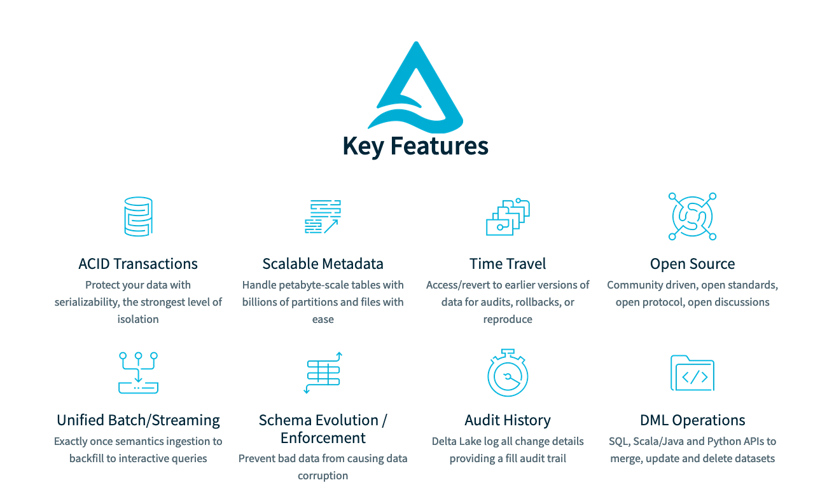
Key Features of Delta Lake
Notes:
Relational tables that support querying and data modification. With Apache Spark, you can store data in Delta tables that support CRUD (create, read, update, and delete) operations. In other words, you can select, insert, update, and delete rows of data in the same way you would in a relational database system.
Support for ACID transactions. Relational databases are designed to support transactional data modifications that provide atomicity (transactions complete as a single unit of work), consistency (transactions leave the database in a consistent state), isolation (in-process transactions can't interfere with one another), and durability (when a transaction completes, the changes it made are persisted). Delta Lake brings this same transactional support to Spark by implementing a transaction log and enforcing serializable isolation for concurrent operations.
Data versioning and time travel. Because all transactions are logged in the transaction log, you can track multiple versions of each table row and even use the time travel feature to retrieve a previous version of a row in a query.
Support for batch and streaming data. While most relational databases include tables that store static data, Spark includes native support for streaming data through the Spark Structured Streaming API. Delta Lake tables can be used as both sinks (destinations) and sources for streaming data.
Standard formats and interoperability. The underlying data for Delta tables is stored in Parquet format, which is commonly used in data lake ingestion pipelines. Additionally, you can use the SQL Endpoint for the Microsoft Fabric lakehouse to query Delta tables in SQL.

Slide 5
Delta Format
A set of files that capture the data and metadata of a table.
Main components:
Parquet data files, possibly organized into partitions
Transaction log stored as JSON files
Checkpoint files
Delta table with three entries in the commit log: mytable/_delta_log/00000000000000000000.json
/mytable/_delta_log/00000000000000000001.json
/mytable/_delta_log/00000000000000000003.json
/mytable/_delta_log/00000000000000000003.checkpoint.parquet
/mytable/_delta_log/_last_checkpoint
/mytable/_change_data/cdc-00000-924d9ac7-21a9-4121-b067-a0a6517aa8ed.c000.snappy.parquet
/mytable/part-00000-3935a07c-416b-4344-ad97-2a38342ee2fc.c000.snappy.parquet
/mytable/deletion_vector-0c6cbaaf-5e04-4c9d-8959-1088814f58ef.bin
Notes:
Delta Lake is an open-source storage layer that adds relational database semantics to Spark-based data lake processing. Tables in Microsoft Fabric lakehouses are Delta tables, which is signified by the triangular Delta (▴) icon on tables in the lakehouse user interface.
Delta tables are schema abstractions over data files that are stored in Delta format. For each table, the lakehouse stores a folder containing Parquet data files and a _delta_Log folder in which transaction details are logged in JSON format.

Slide 6
Delta Table Transactions
Version 0
Version 1
Version 2
Add 1.parquet
000000.json
000001.json
000002.json
Add 2.parquet
Transaction log entries
Remove 1.parquet
Remove 2.parquet
Add 3.parquet
Add file 1
Remove file 1
Add file 2
Remove file 2
Add file 3
Notes:
As an example, we may create a table with 5 records, file 1. We may later add more records, file 2. We then delete some records from file 1 and 2. In the Delta table folder, a new file 3 is added that contains the undeleted records. Alongside these parquet files, we have the transaction log JSON files, capturing each change. This is what allows for time travel, viewing a table at a specified point in time in the past.

Slide 7
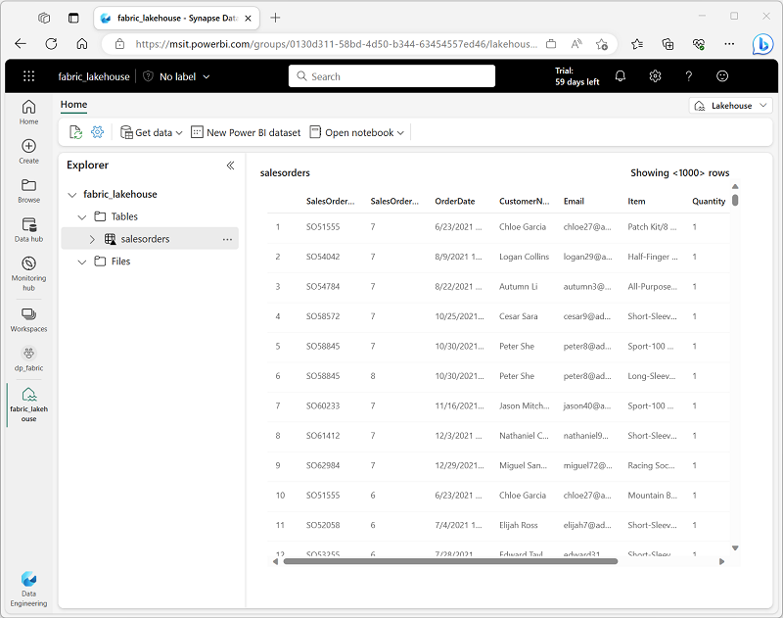
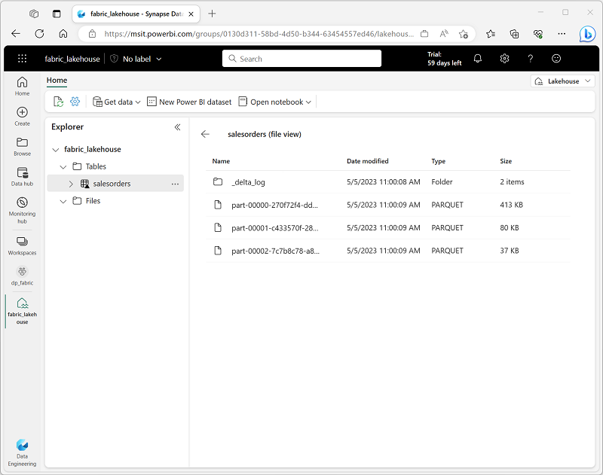
Delta Lake in Fabric
Notes:
Delta Lake is an open-source storage layer that adds relational database semantics to Spark-based data lake processing. Tables in Microsoft Fabric lakehouses are Delta tables, which is signified by the triangular Delta (▴) icon on tables in the lakehouse user interface. Delta tables are schema abstractions over data files that are stored in Delta format. For each table, the lakehouse stores a folder containing Parquet data files and a _delta_Log folder in which transaction details are logged in JSON format

Slide 8
Create Delta Tables in Fabric
You can create a delta table directly from within a Spark dataframe
You can create managed or external tables
External tables do not have their underlying data deleted in the event of metastore deletion
Managed tables have both their metadata and underlying data managed by Spark for the Fabric Lakehouse—deleting a table will delete the metadata and underlying files
You can also create delta tables using the DeltaTableBuilder API or Spark SQL
Spark provides you the option of saving data in delta format from PySpark
Notes:
When you create a table in a Microsoft Fabric lakehouse, a delta table is defined in the metastore for the lakehouse and the data for the table is stored in the underlying Parquet files for the table.
With most interactive tools in the Microsoft Fabric environment, the details of mapping the table definition in the metastore to the underlying files are abstracted. However, when working with Apache Spark in a lakehouse, you have greater control of the creation and management of delta tables.
While it's common to create a table from existing data in a dataframe, there are often scenarios where you want to create a table definition in the metastore that will be populated with data in other ways. There are multiple ways you can accomplish this goal.
So far you've seen how to save a dataframe as a delta table (creating both the table schema definition in the metastore and the data files in delta format) and how to create the table definition (which creates the table schema in the metastore without saving any data files). A third possibility is to save data in delta format without creating a table definition in the metastore. This approach can be useful when you want to persist the results of data transformations performed in Spark in a file format over which you can later "overlay" a table definition or process directly by using the delta lake API.

Slide 9
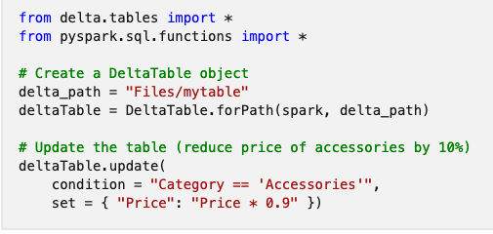
Working with Delta Tables in Spark
The most common way to work with delta tables is to use Spark SQL
Alternatively, if you want to work directly with the delta files, rather than tables, you can also use the Delta Lake API
Notes:
The most common way to work with data in delta tables in Spark is to use Spark SQL. You can embed SQL statements in other languages (such as PySpark or Scala) by using the spark.sql library.
When you want to work with delta files rather than catalog tables, it may be simpler to use the Delta Lake API. You can create an instance of a DeltaTable from a folder location containing files in delta format, and then use the API to modify the data in the table.

Slide 10
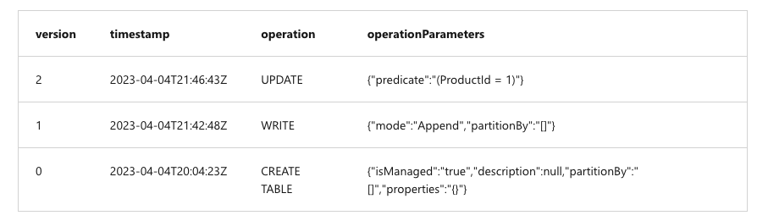
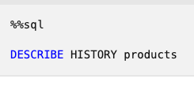
Working with Time Travel
Changes to delta tables are logged in the table’s transaction log
You can use those logged transactions to retrieve older versions of the data
To do this—you can use the DESCRIBE SQL command as shown below

Slide 11
Using Delta Tables with Streaming Data
Spark includes support for streaming data natively through Spark Structured Streaming
You can use a delta table for a source or target for Spark Structured Streaming
Notes:
A typical stream processing solution involves constantly reading a stream of data from a source, optionally processing it to select specific fields, aggregate and group values, or otherwise manipulate the data, and writing the results to a sink.
Spark includes native support for streaming data through Spark Structured Streaming, an API that is based on a boundless dataframe in which streaming data is captured for processing. A Spark Structured Streaming dataframe can read data from many different kinds of streaming source, including network ports, real time message brokering services such as Azure Event Hubs or Kafka, or file system locations.
You can use a delta table as a source or a sink for Spark Structured Streaming. For example, you could capture a stream of real time data from an IoT device and write the stream directly to a delta table as a sink - enabling you to query the table to see the latest streamed data. Or, you could read a delta as a streaming source, enabling you to constantly report new data as it is added to the table.

Slide 12
Summary
Delta tables add a great deal of functionality and allow Data Lakehouse architectures to be more robust
Spark supports a wide variety of methods for interacting with, creating, and ingesting data into delta tables
You can take advantage of time travel in delta tables to do temporal queries
You can use delta tables as a source or target for streaming data with Spark

Slide 13

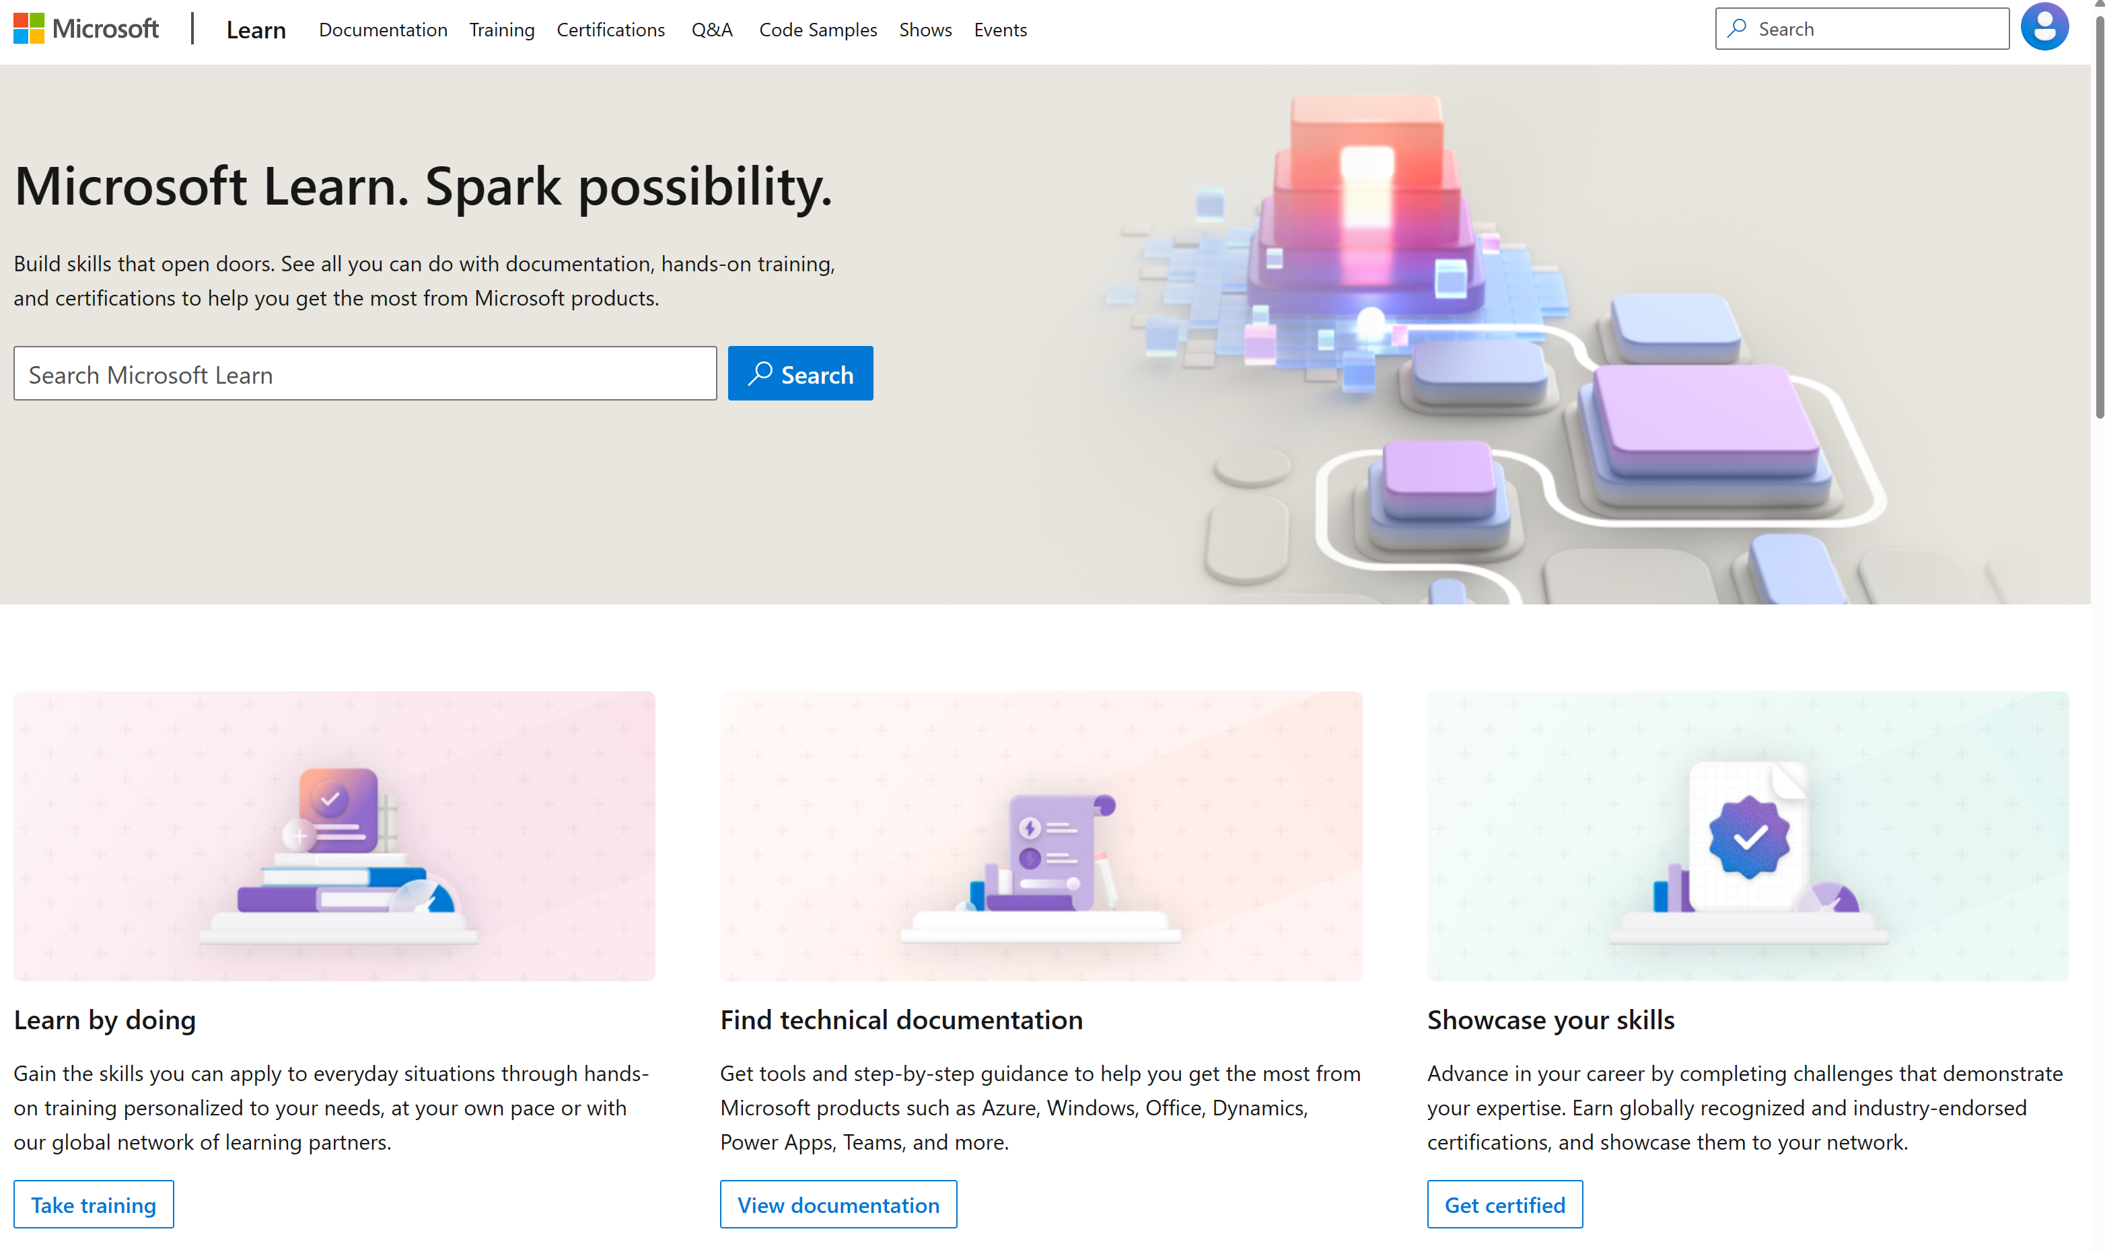
Microsoft Learn Demo
Microsoft Learn: Build skills that open doors in your career

Slide 14
Readiness and Enablement Links
The Microsoft Federal Team is here to help you accelerate customers' digital transformation. Microsoft Federal has tailored to make your organizations skilling journey successful. From the Business Decision Maker to the technical community and end-users, Microsoft provides customers with access to endless skilling resources. Below you will find links to these resources:
Get training tailored to your organization's needs: Find learning paths for specific roles in your organization, plus course recommendations based on technology, skill level, and solution area: Training | Learning Portal (microsoft.com)
Events Calendar - US Partner Community Blog – Microsoft
In addition to the above, the Microsoft Federal Team can address the needs of your non-technical community of your learners through:
Skilling Hours - Readiness and Enablement: Skilling our Federal Customers and Partners (office.com)
Microsoft Learning Portal: A closer look at Azure through training modules and gamified learning
Microsoft Learning Portal
Additional Learning Resources:
Get started with Azure – Introduction | Microsoft Azure
Microsoft Learn (path-based)
Exam-based: Select filters: Azure, D365, M365, Power Platform, and more
Microsoft Virtual Training Days – Virtual Instructor Led
Microsoft Technology Center - Work through your Account Manager
Home - Microsoft Tech Community
Microsoft Reactor | Microsoft Developer – Virtual Instructor Led

